Slide 1

ANTI-VACCINATION AND SOCIAL MEDIA: Studying the spread of COVID-19 Disinformation on Reddit
Matthew Fikes
DSC680

Slide 2
Background - Reddit
Communities = subreddits
Community administrators = moderators
Upvotes and downvotes measure popularity
Notes:
Before I get into the discussion of disinformation, I’d like to go over the background of Reddit so terminology is clear.
Reddit is a website founded in 2005 by Steve Huffman, Aaron Swartz, and Alexis Ohanian as the “front page of the Internet” after coming up with the idea while at the University of Virginia (Wikimedia Foundation, 2021).
The site is organized into user-created communities. These are called subreddits, and are usually focused on a specific topic. References to a subreddit are commonly prefixed with an r slash.
These range widely, with subreddits for politics and science and then subreddits for pictures of birds with arms and bread stapled to trees.
Each subreddit is maintained by one or more volunteer users known as moderators. They have the power to remove posts and ban users and can shape the way a community develops.
Every submission is voted on by users with upvotes and downvotes that raise or lower the overall score of the post, affecting visibility in the community and the site as a whole.
Posts and comments accumulate upvotes and downvotes, and the ratio of these is what gives each user karma, a point score that can be used to limit posting within a community or a measure of user engagement.

Slide 3
Disinformation on Reddit
August 25, 2021 Reddit co-founder Steve Huffman comments on the situation and supports dissent of opinion related to COVID vaccination.
54 other subreddits were quarantined, requiring click-through confirmation to view
September 1, 2021 Reddit banned the subreddit NoNewNormal
Notes:
On August 25th 2021 Reddit co-founder and CEO Steve Huffman, username spez, made a statement on the official announcements subreddit to address concerns about anti-vaccine messages spreading on the site. In the message he acknowledges the importance of following CDC guidance, but states that “dissent is a part of Reddit and a foundation of Democracy”. The official position was to allow these communities to exist because they encourage debate and discussion. Ultimately, they found that disagreeing with CDC information was not against their policies.
When this message was posted, moderators of at least 135 subreddits made them private in protest. This prevented users from accessing large portions of the site.
A week later, on September 1st, Reddit changed direction and banned the primary subreddit for disinformation, NoNewNormal. They claimed this was not due to disinformation, but for breaking rules against brigading other communities to affect the scores used to calculate karma. In addition to NoNewNormal, 54 subreddits were quarantined. This meant clicking through a warning screen acknowledging the community quarantine and the content was not indexed in site searches.

Slide 4
Data Source
LockdownSkepticism
DebateVaccines
TakeTheJab
Conspiracy
Collected via Python Reddit API Wrapper (PRAW)
4 subreddits to focus on:
Notes:
The data source was directly from the official Reddit API.
To access it, I used a Python library called PRAW, or Python Reddit API Wrapper.
For this study, I chose four subreddits to collect information from. These were chosen based on experience using Reddit and exploring some of the popular posts.
These subreddits are LockdownSkepticism, DebateVaccines, TakeTheJab, and Conspiracy.

Slide 5
Data Source
Data collected for subreddit moderators and users who post submissions
data retrieved within limit of API: 1000 records
top 10 subreddits based on karma for posts and comments
Notes:
For each subreddit I collected post and comment information for the community moderators and users who had posted within the limits of the API, which is the last 1000 records.
After pulling this data I limited the combined karma totals for each subreddit to the top 10 for each user. Collecting more was possible but it made the network graph overly complex and many connections were also weak. A quick look at some of the subreddit titles with weak connections do not indicate any connection with disinformation.

Slide 6
Data Prep
Lists of moderators for targeted subreddits created for API extraction
Top 10 results for each moderator and user were grouped by target subreddit and summed.
Comment and post karma for each user was combined prior to sorting
Sorted totals allow for limiting by top n for analyses
For Network Model:
Moderator and user data grouped totals were melted into rows to make structure for network
Source disinformation subreddits | Target Other subreddit interacted with | Weight Karma total for target based on aggregated total of source
Notes:
The moderators were pulled from the API and indexed into a dataframe. Dictionaries of post and comment information were written to the dataframe for each user. That data was looped though to find totals for each unique subreddit listed in the dataframe. The result was a dataframe that could be melted into individual rows for use with the network model.
This method was repeated with data for users who were found posting in the target subreddits.
Both were then sorted by totals for aggregation and comparison.
The network model required the data be set into row records with a source and target at the minimum, with optional values including weight.
For this model, the source nodes will be the four disinformation subreddits.
Target will be the subreddits users and moderators interact with, and weight will be the karma total for the target field that is based on an aggregate total from the source.

Slide 7

Data Exploration
55 moderators - no crossovers in moderation
1302 users, 1259 unique
6 users posted to three, 31 posted to two
Notes:
Viewing user data reviews fifty five moderators between the four target disinformation subreddits. While moderating more than one subreddit is not an uncommon thing, there is no crossover on these moderator lists. This indicates that control of each is separate, assuming usernames are not controlled by the same person behind the scenes.
Looking at users found 1302 users who posted to any of the four disinformation groups. Of those, 1259 were unique.
While reddit admins suggested leaving out unique user names to protect against brigading or any kind of retaliatory witch-hunting, I can still look at trends.
Six of the 1259 users posted to three of the four disinformation subreddits, and 31 posted to two.

Slide 8
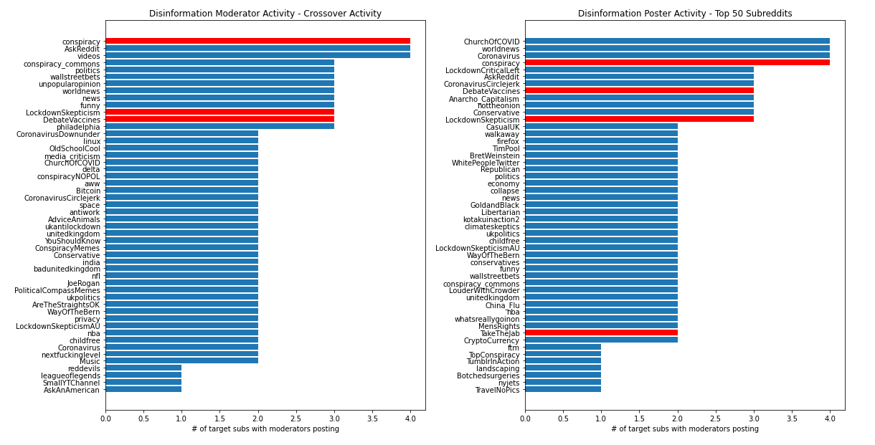
Crossover Posting Activity
Notes:
These horizontal bar graphs show crossover activity for moderators on the left and users on the right. What the interval on the x axis here means is the number of target disinformation subreddit users or moderators participate in those communities.
This is an effort to find other places where disinformation might be, or how interconnected these are already.
Several subreddits emerge that may warrant further investigation that are high on the list – conspiracy_commons, ChurchOfCOVID, conspiracyNOPOL, LockdownCriticalLeft, and CoronaVirusCircleJerk stand out.

Slide 9
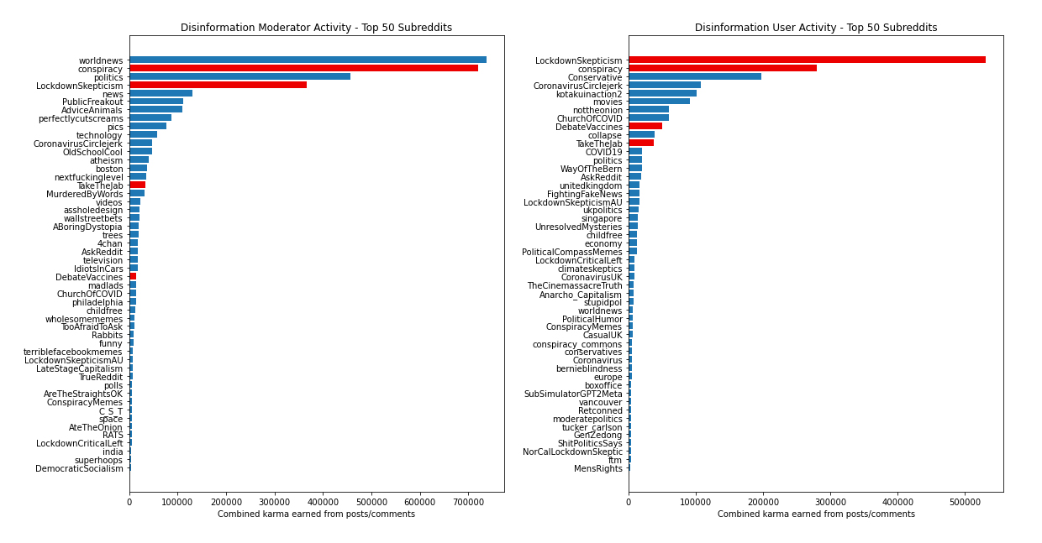
Moderator and User Engagement
Notes:
Overall activity tells a similar story to the crossover information. Moderator activity tended to be lower in moderated target subreddits compared to user activity. Highest moderator activity trended towards political subreddits and users had more related to disinformation and conspiracy.
There are many communities here that would be unrelated to disinformation, like Rabbits or AskReddit. With that said, the names of user subreddits seem to stay closer to things relating to conservative politics and conspiracy posting. The overall moderator activity shows more well-rounded interests.

Slide 10
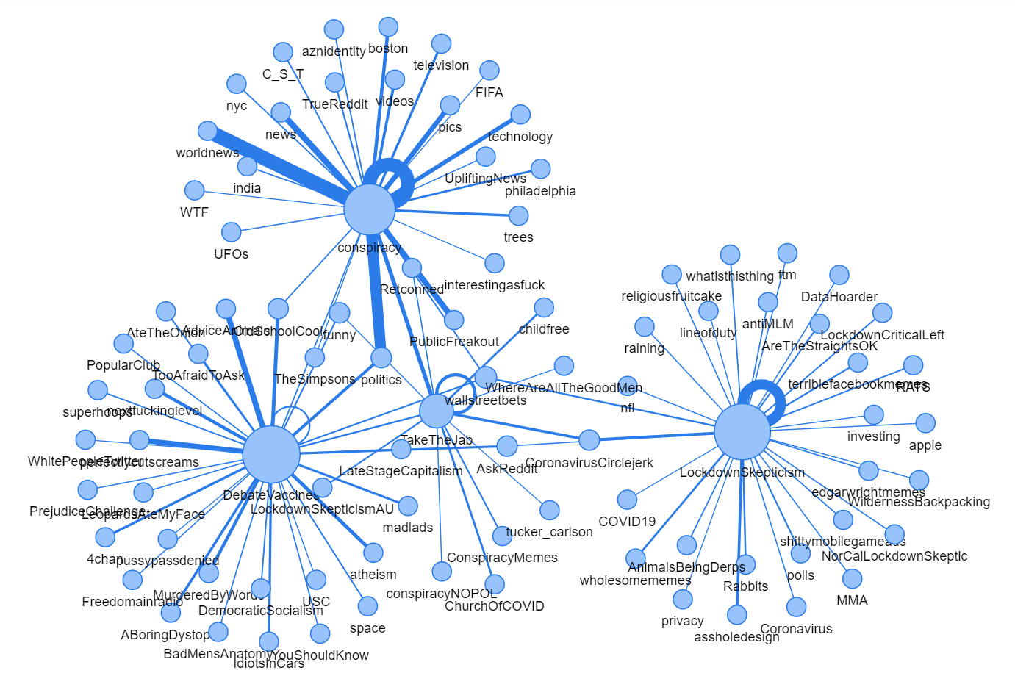
Moderator
Graph Network
Notes:
Here is a graph network of moderator activity. The largest nodes are the disinformation subreddits, and sized by the number of posts. Line weights are the total karma gained by moderators of the disinformation subreddits.
Conspiracy moderators appear to make the most concentrated posts of all the disinformation groups. It is interesting that LockdownSkepticism is the least connected to the rest, The only connections it shares with any other disinformation group is wallstreetbets, AskReddit, and CoronavirusCirclejerk. AskReddit is a default subreddit shown to everyone and commonly posted in, and wallstreetbets is a stock trading subreddit that leans towards conservative users and memes.

Slide 11
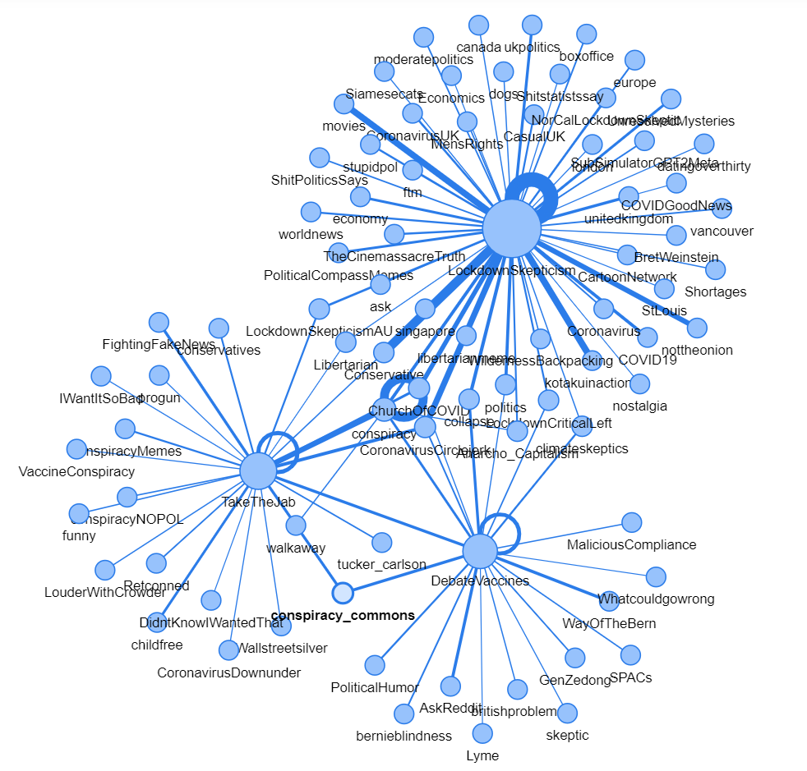
User
Graph Network
Notes:
This is the graph network for user activity. Like the first graph, large nodes are the target subreddits. Line weights are the total karma gained by users found posting in the disinformation subreddits.
LockdownSkepticism users post much more widely than the other subreddits. Users of conspiracy are so tied within the graph that it is only perceptible by the heavy weighted line going back to itself in a circle.
It is interesting that conspiracy_commons is not posted in by conspiracy users, but it is possible that users are banned from the conspiracy subreddit for breaking rules.

Slide 12
Results
Several users stood out in individual results for posting often. A single user made 322 posts to the TakeTheJab subreddit, and another user posted 76 times to DebateVaccines with an additional 61 to TakeTheJab.
The target subreddits have user crossover, with users commonly posting to several of the targets.
Other communities were identified outside the original scope that are likely to contain disinformation based on the title.
Notes:
Here are some results to take away from the study.
There were several users that stood out from the data because of their prolific posting habits.
One user, who was also a moderator, made 322 posts to a single subreddit, TakeTheJab. Another user posted 76 times to DebateVaccines and 61 to TakeTheJab. Some users are clearly much more prolific and clearly in this case the moderator strongly supports their community.
The disinformation subreddits have several users in common, with a number of them posting to several of the subreddits. Approximately .5% of users identified posted to 3 out of 4 of the target communities and about 3% posted to two or more. This is not a large percentage, but shows that there is a small but dedicated group of users who post to disinformation groups.
The project also brought light to several other communities participated in by users that are likely to contain disinformation, based solely on the titles of the subreddits. I mentioned some of them earlier, but it seems that one in particular, ChurchOfCOVID, has a particularly strong presence at least in data collected on users.

Slide 13
Limitations
API limitations mean that historical data is unavailable, and data changes often on social media.
September ban/quarantine of disinformation subreddits made it harder to collect a wide range of community data
Notes:
The primary limitation working on this project was the limitations of the API. Reddit does not allow access to historical records beyond the last 1000. A comprehensive study over time would require daily data collection and then combination of the collected information.
There are also limitations because of the ban and quarantine of many subreddits in September. Posts from banned subreddits are not available on the side, and quarantined subreddits can be accessed but not by the API. Any user who has been suspended or banned also has their account history made inaccessible, so people who are most likely to break rules are also most likely to be missing from the data.

Slide 14
Next Steps
Pull moderator and user data for subreddits uncovered in exploration
1
Get second level of network graph to see how further connections feed back
2
Explore content of posts to see how often messages are repeated word frequencies
3
Notes:
There are several steps that can be taken with the results moving forward.
With the subreddits uncovered in the user data, the same process of pulling moderator and user data could be performed. This should broaden the net of disinformation being analyzed and see how connections compare with the existing ones.
Another opportunity to expand the existing network exists in running the same data collection on the subreddits found in the first round. This will uncover any connections between those moderators and the target subreddits and see how user activity broadcasts over communities.
The largest task would be analyzing the actual content of the posts. The text could be analyzed for both sentiment and word frequency. This could help measure how much volume of user activity is actually generating or sharing disinformation instead of just looking at broad community activity. Additionally, looking at timing of the posts could show if there is concerted work to broadcast messages at certain times of the day or to counteract specific media messages as they come out in the news.

Slide 15
References
Wikimedia Foundation. (2021, November 7). Reddit. Wikipedia. Retrieved November 9, 2021, from https://en.wikipedia.org/wiki/Reddit.

